Slide 1

Brain Tumor Stage-Based Recurrence Patterns
Dataset Overview and Exploratory Analysis
Submitted by: Dana Sela 314813429, Miriam Chavay 213287790, Ayal Adler 209520998, Tamar Krakover 213273105.
Submission Date: 15 \ 01 \ 26
Course: Data Analysis in Python

Slide 2
Dataset Overview
Dataset name: Brain Tumor Stage-Based Recurrence Patterns
Source: Kaggle
Direct link to dataset:
https://www.kaggle.com/datasets/thegoanpanda/brain-tumor-stage-based-recurrence-patterns/data
File type: CSV file
Link to Github:
https://github.com/seladan1/Final-Project.git

Slide 3
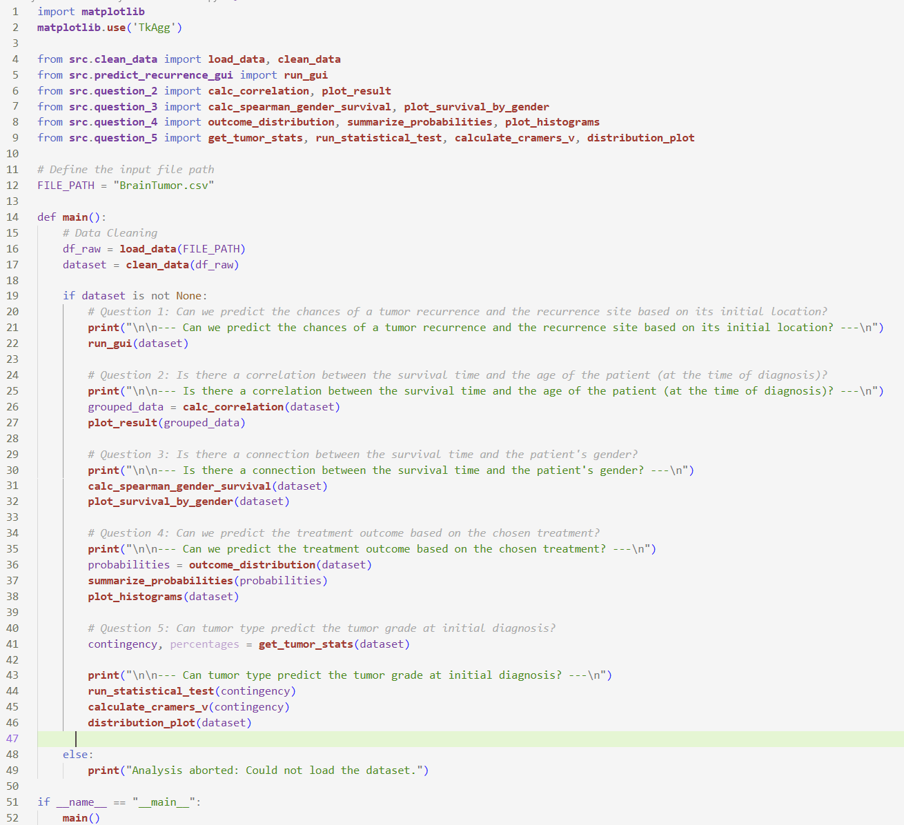
Main ()

Slide 4
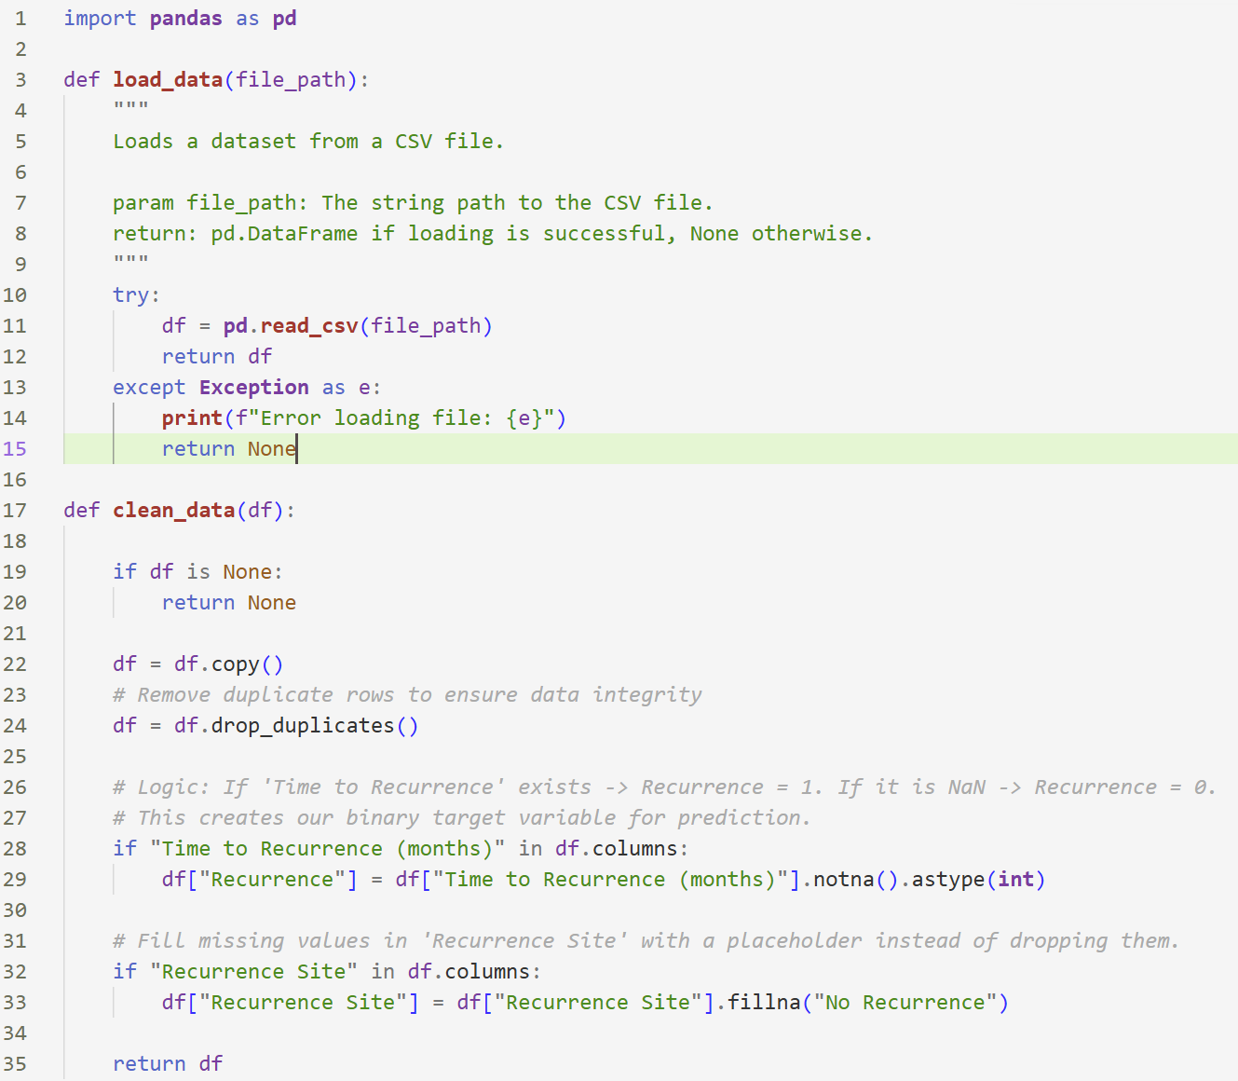
Clean data

Slide 5
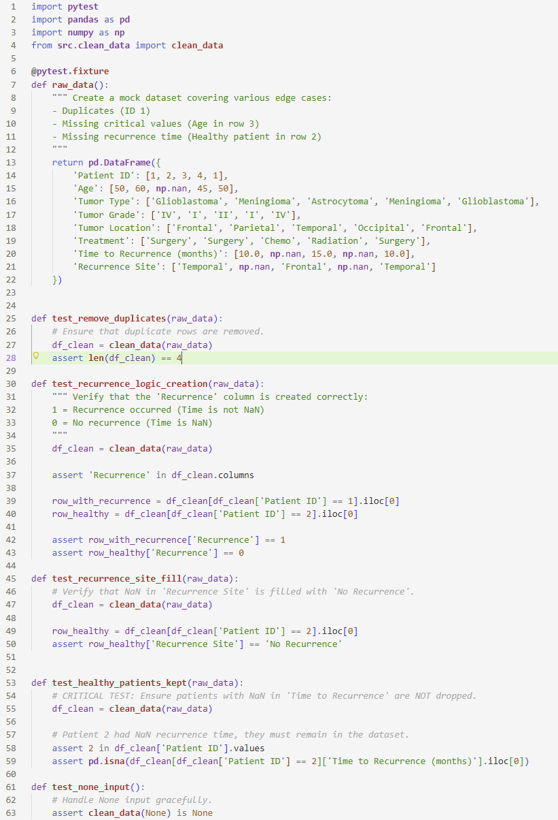
Clean data
Test

Slide 6
The Core Questions
Can we predict the chances of a tumor recurrence based on data parameters?
Is there a correlation between the survival time and the age of the patient (at the time of diagnosis)?
Is there a connection between the survival time and the patient's gender?
Can we predict the treatment outcome based on the chosen treatment?
Can tumor type predict the tumor grade at initial diagnosis?

Slide 7
P value
The p value is a statistical measure that indicates the probability that the observed results occurred by chance. Typically, a p value less than 0.05 is considered statistically significant, meaning we would expect to see such results in less than 5% of cases if there were actually no real effect. It is used to determine whether a relationship or difference between variables is likely real or just due to random variation.

Slide 8
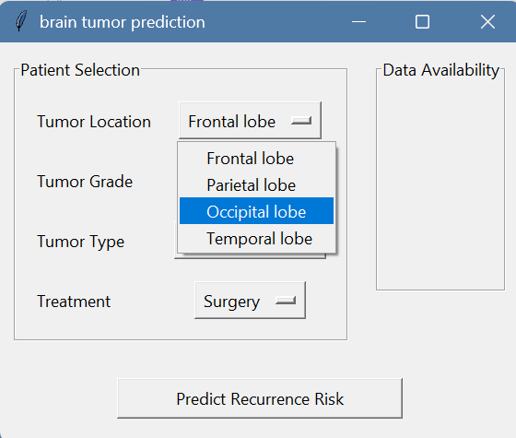
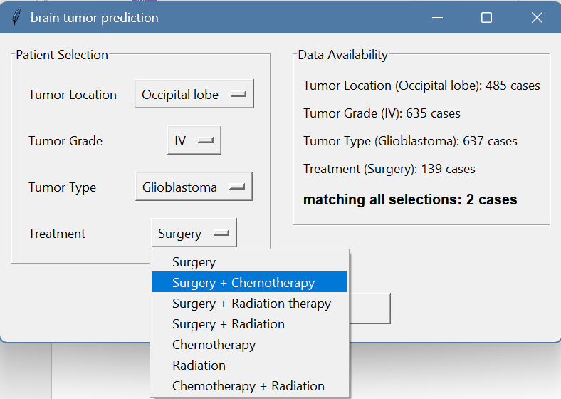
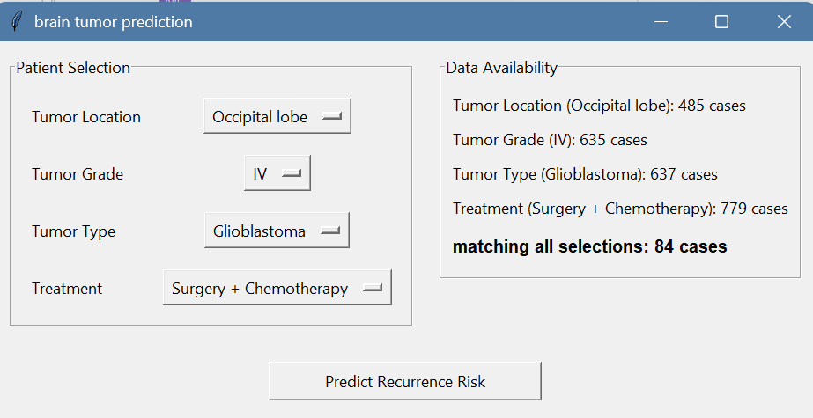
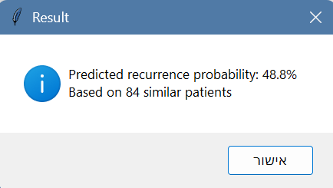
1. Can we predict the chances of a tumor recurrence based on data parameters?
Results
We were interested in exploring relationships between variables, but we also wanted a practical outcome from the project. Since true outcome prediction belongs mainly to Machine Learning, we shifted our focus to developing a GUI that estimates tumor recurrence probability using probabilistic group intersections. A new binary column marks recurrence (1) or no recurrence (0), and probabilities are calculated by dividing the number of recurrences by the total number of patients in each group.

Slide 9
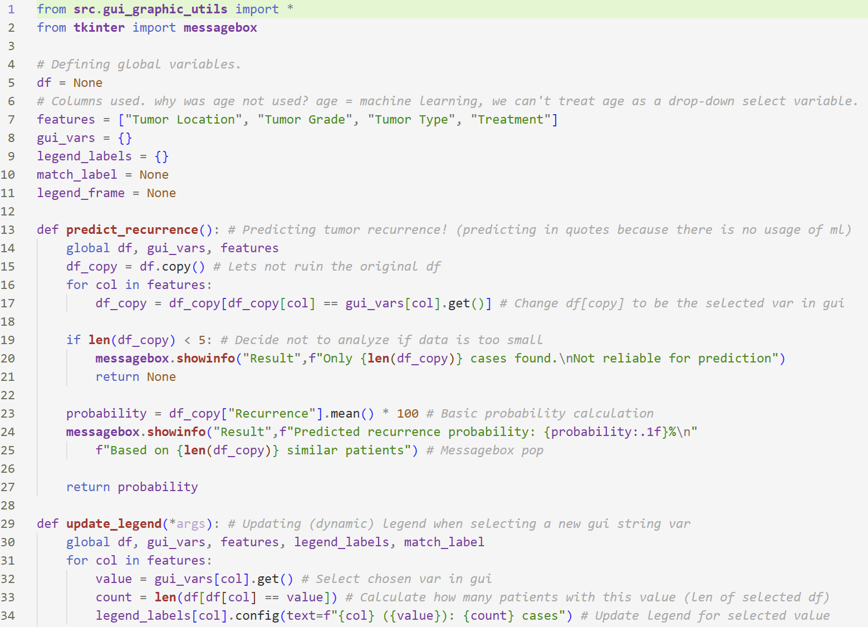
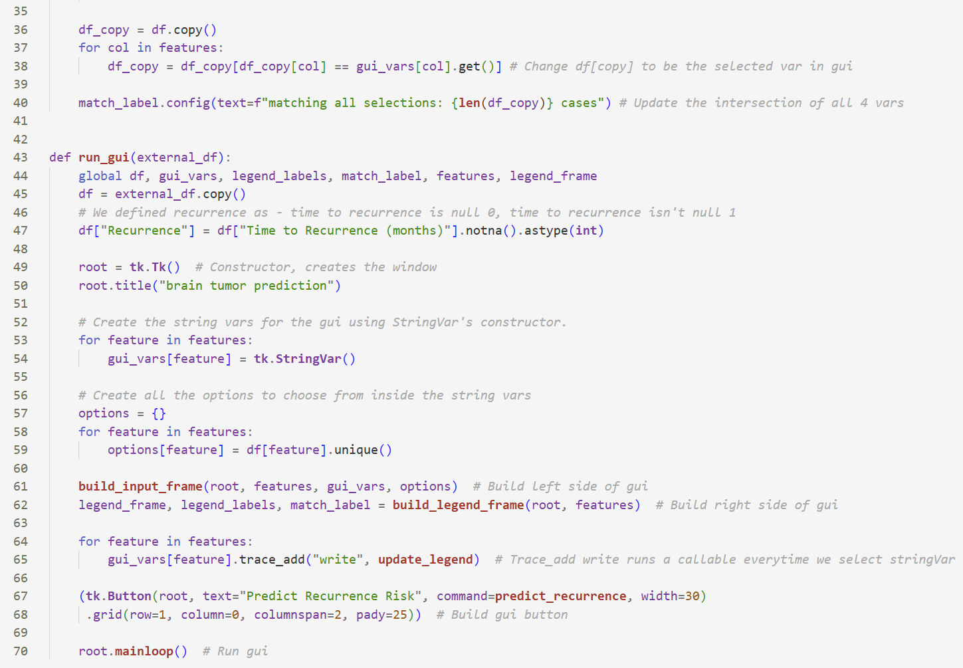
1. Can we predict the chances of a tumor recurrence based on data parameters?
Final code

Slide 10
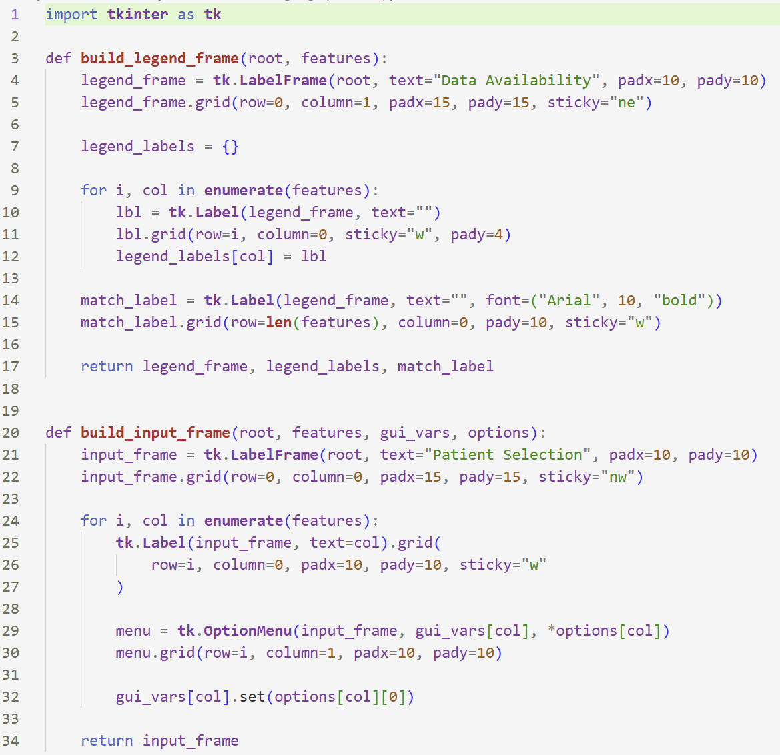
1. Can we predict the chances of a tumor recurrence based on data parameters?
Final code – GUI graphic design

Slide 11
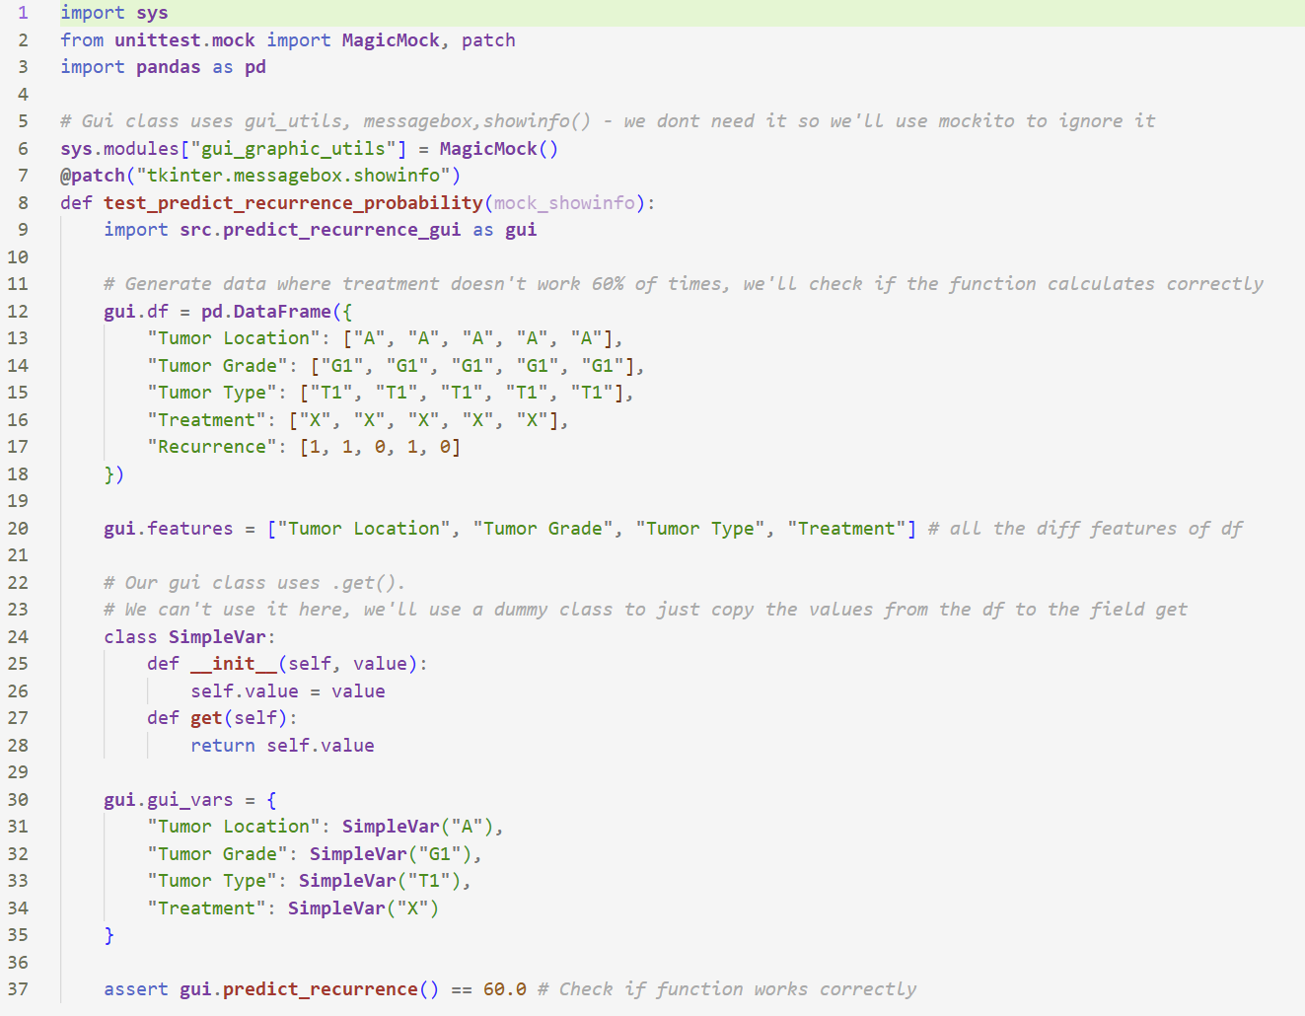
1. Can we predict the chances of a tumor recurrence based on data parameters?
Tests

Slide 12
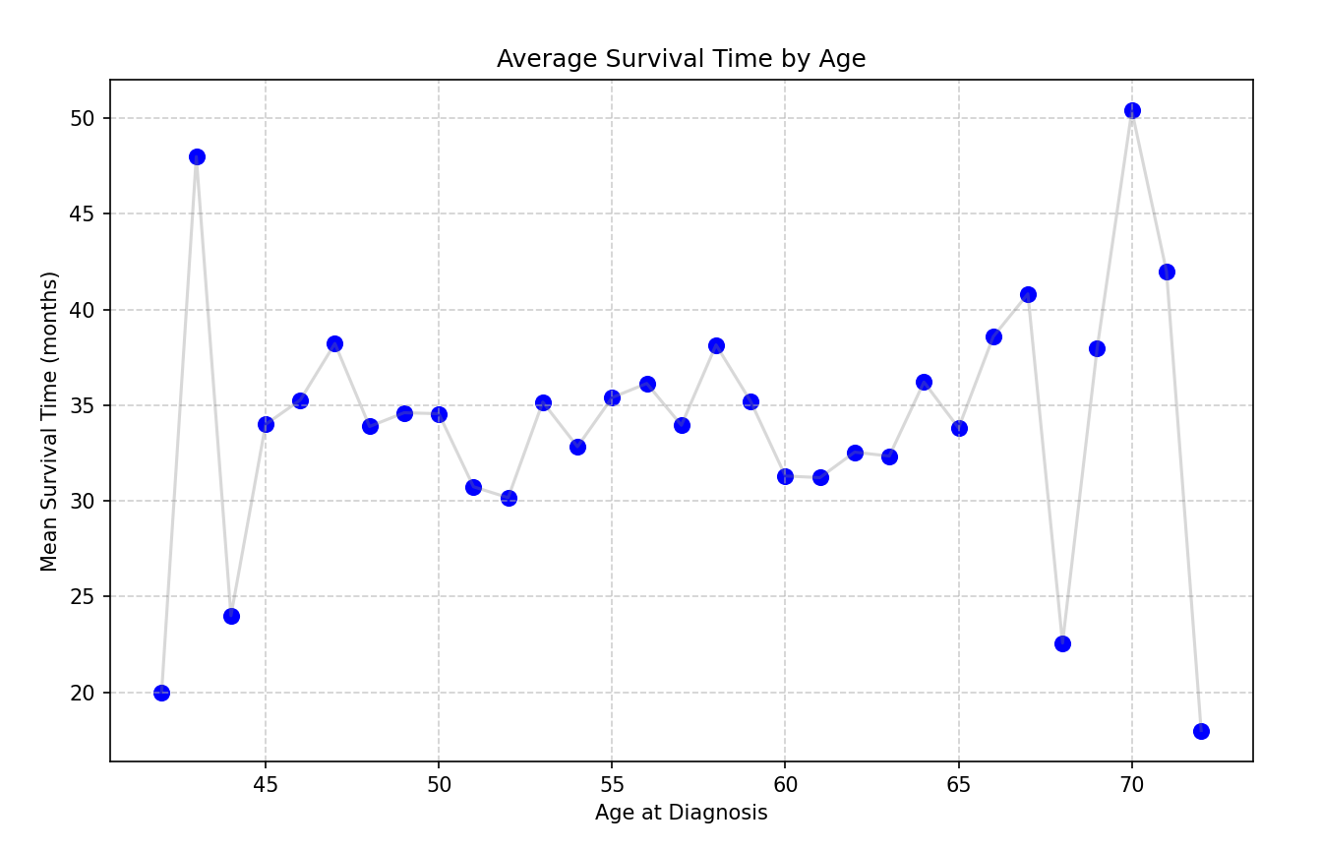
2. Is there a correlation between the survival time and the age of the patient (at the time of diagnosis)?
Results
The assumption was that there is a connection between age and survival time, and the results indicated that there is not.
Pearson correlation was used because both age and survival time are continuous variables, making it appropriate for testing a linear relationship. The data was grouped by age and average survival time was used to reduce noise and better satisfy Pearson’s assumptions.

Slide 13
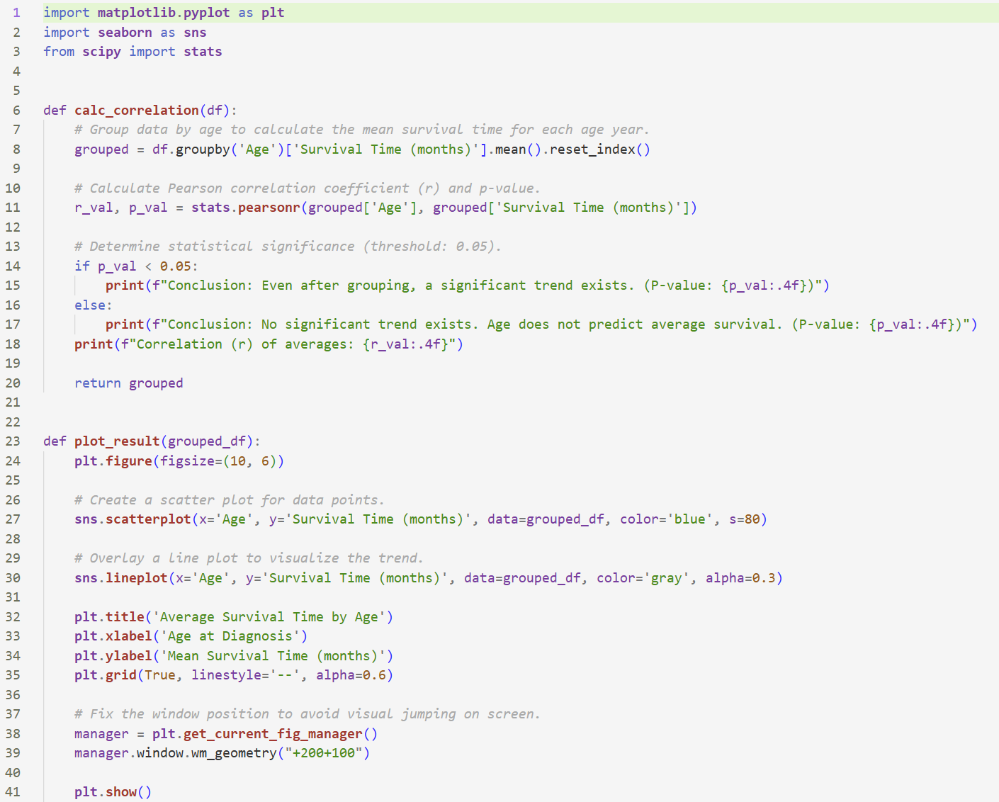
2. Is there a correlation between the survival time and the age of the patient (at the time of diagnosis)?
Final code

Slide 14
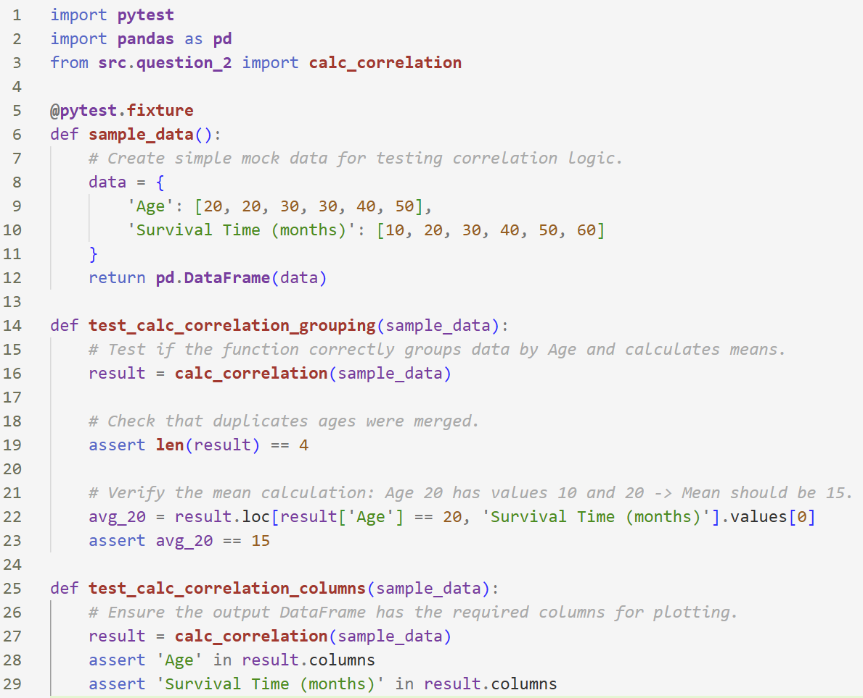
2. Is there a correlation between the survival time and the age of the patient (at the time of diagnosis)?
Tests

Slide 15
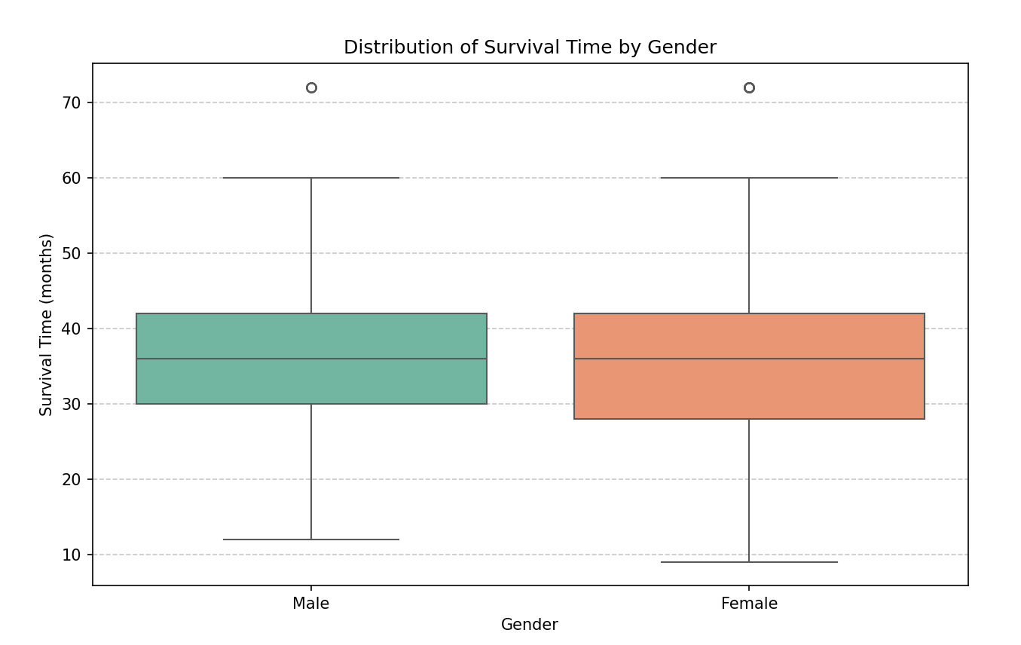
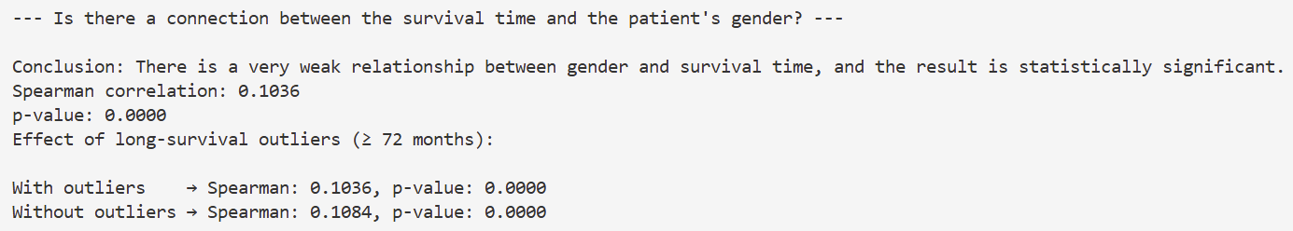
3. Is there a connection between the survival time and the patient's gender?
Results
The assumption was that survival time may differ by gender, the result was there is a very weak connection.
Spearman correlation was used because gender is a categorical variable encoded numerically and survival time may not be normally distributed. The box plot visually compares survival distributions between genders, and testing the effect of long survival outliers showed minimal impact on the Spearman coefficient and p-value, indicating stable results.

Slide 16
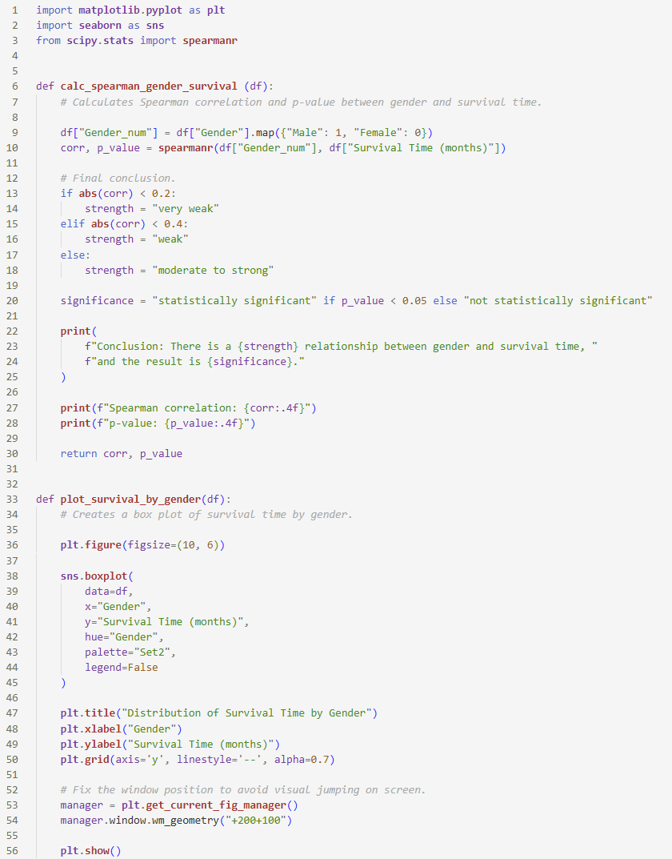
3. Is there a connection between the survival time and the patient's gender?
Final code

Slide 17
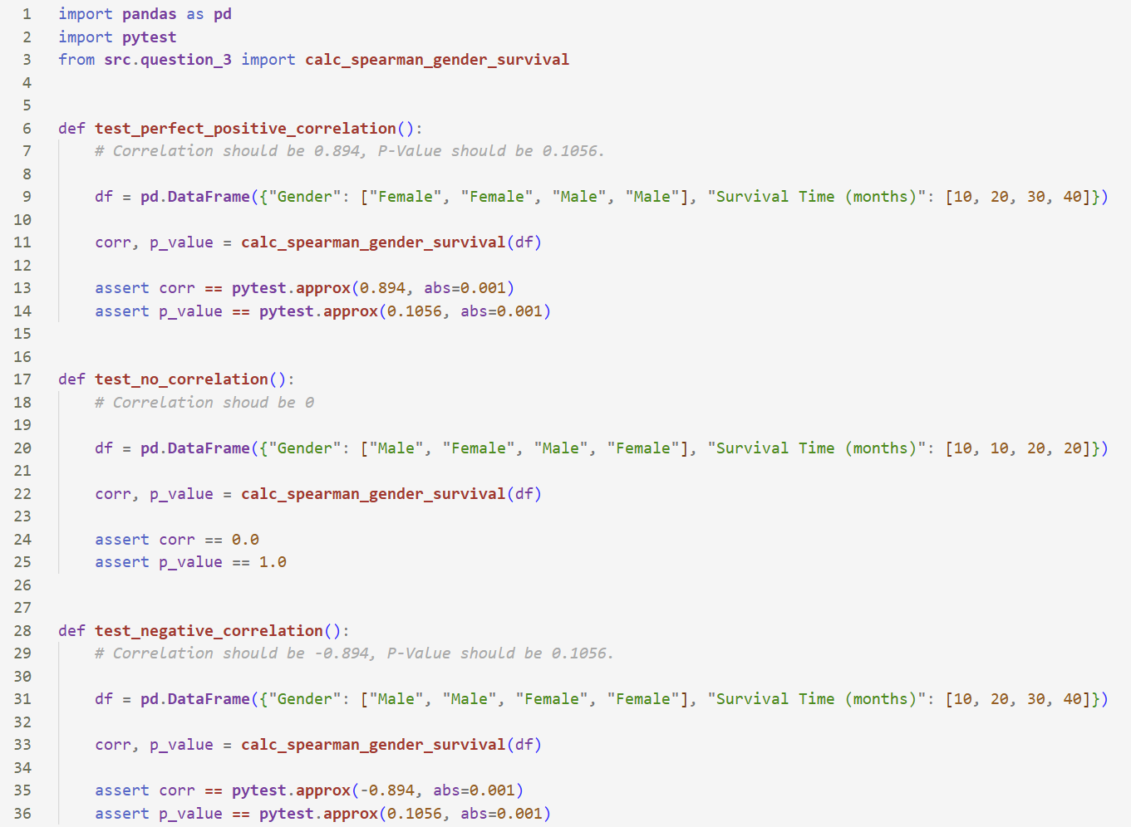
3. Is there a connection between the survival time and the patient's gender?
Tests

Slide 18
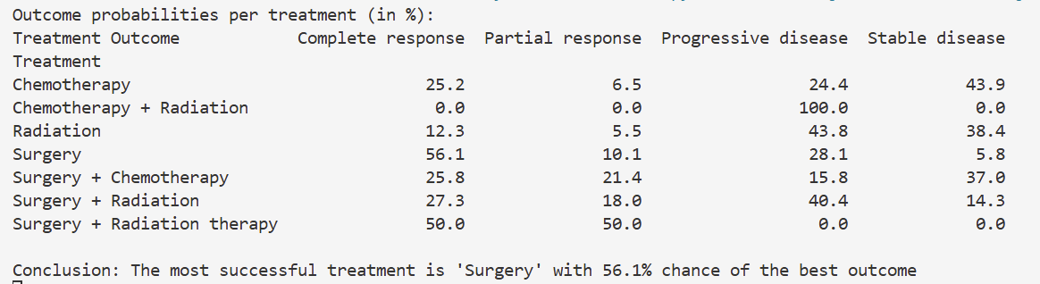
4. Can we predict the treatment outcome based on the chosen treatment?
Results
The initial hypothesis was that treatment outcomes could be predicted, and the hypothesis was correct.
The code computes outcome probabilities for each treatment using cross-tabulation, allowing a fair comparison between treatments. It then visualizes the outcome distributions with bar charts to clearly show how outcomes differ across treatments. Together, the probabilities and plots help identify the most effective treatment and support the final conclusion.

Slide 19
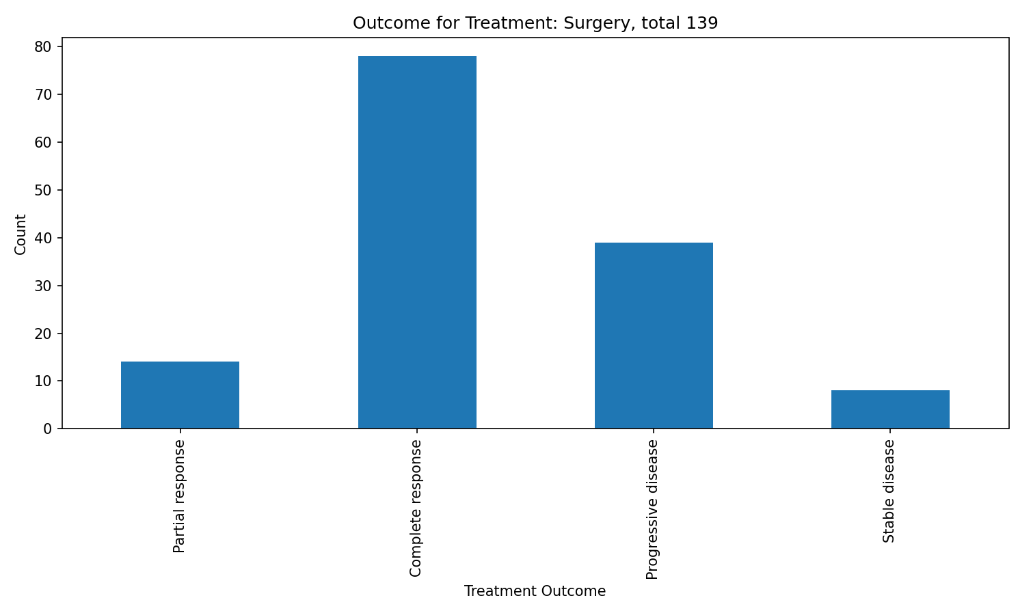
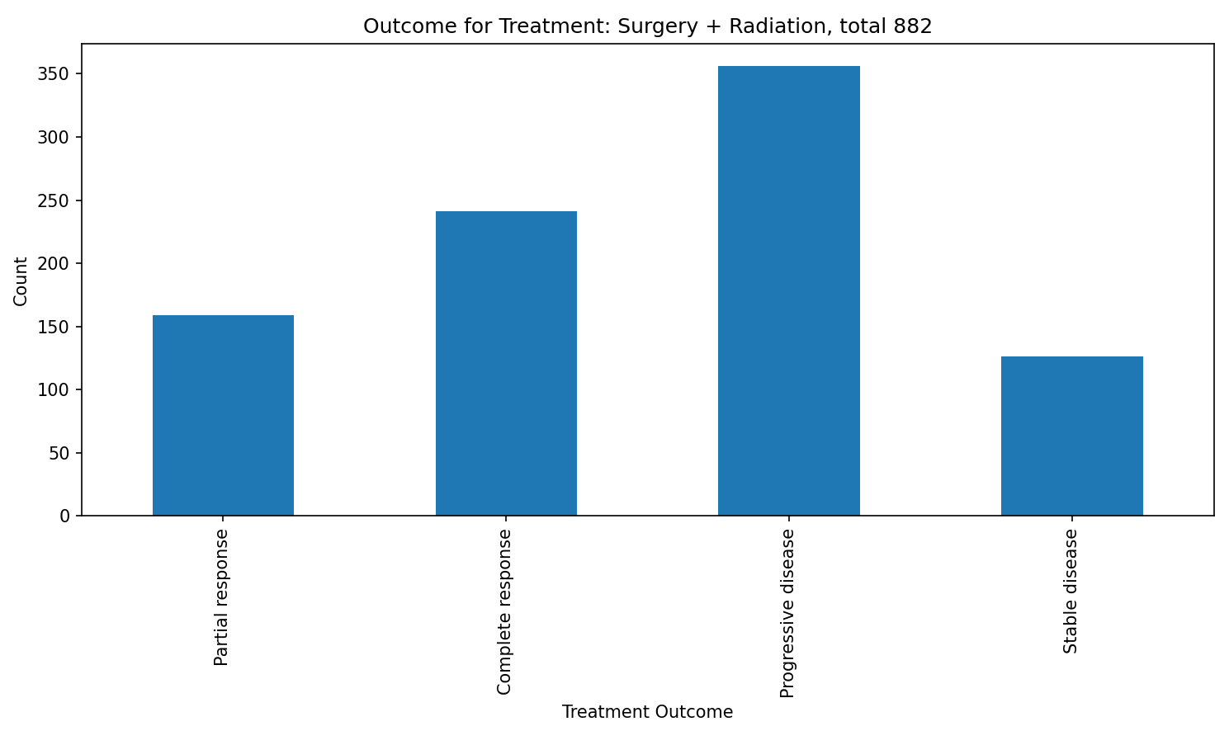
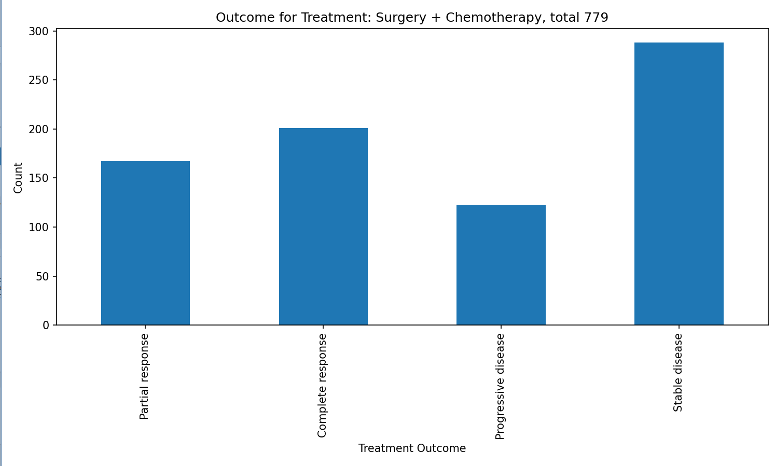
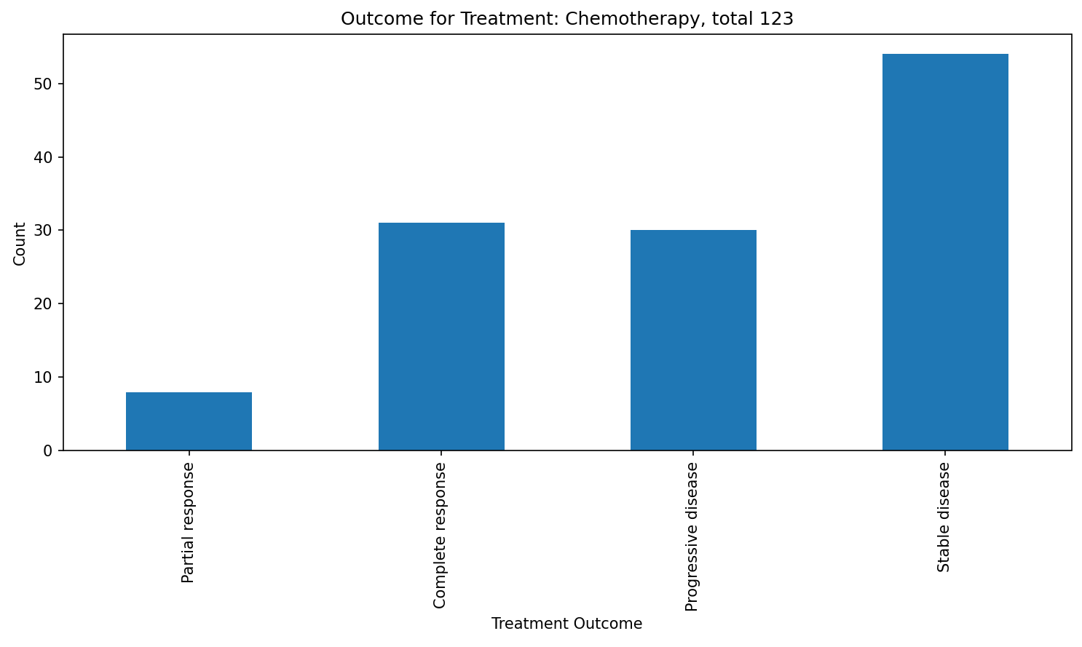
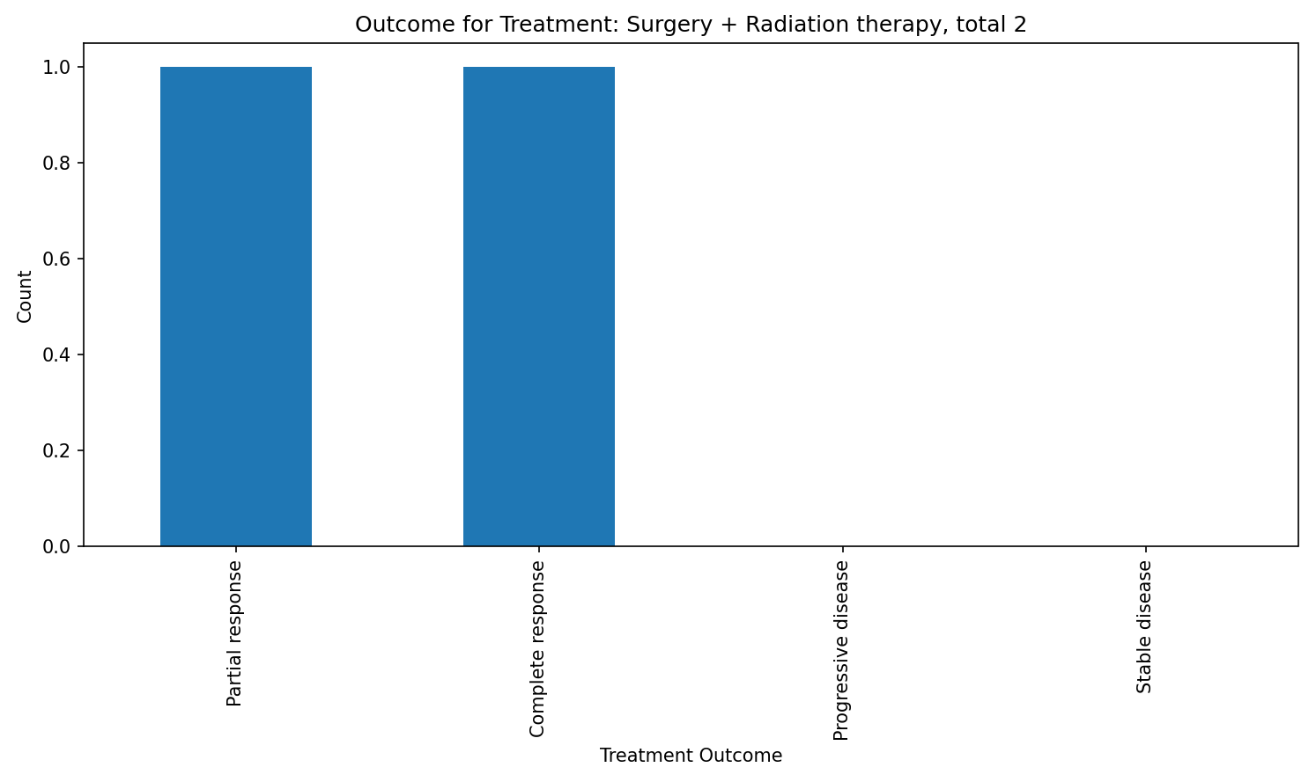
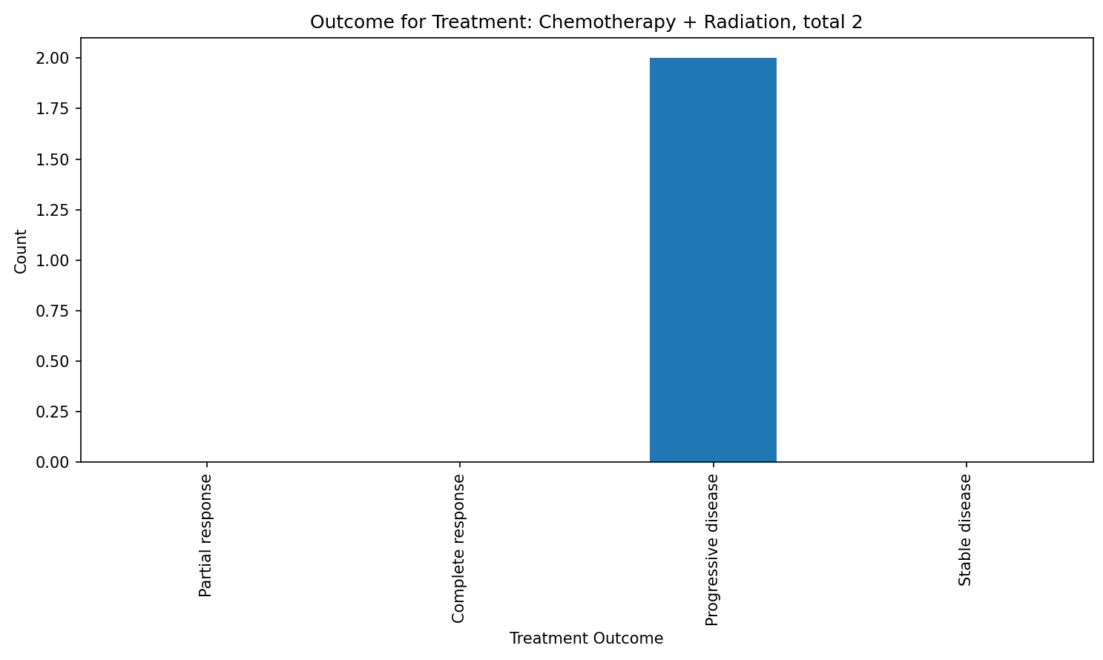
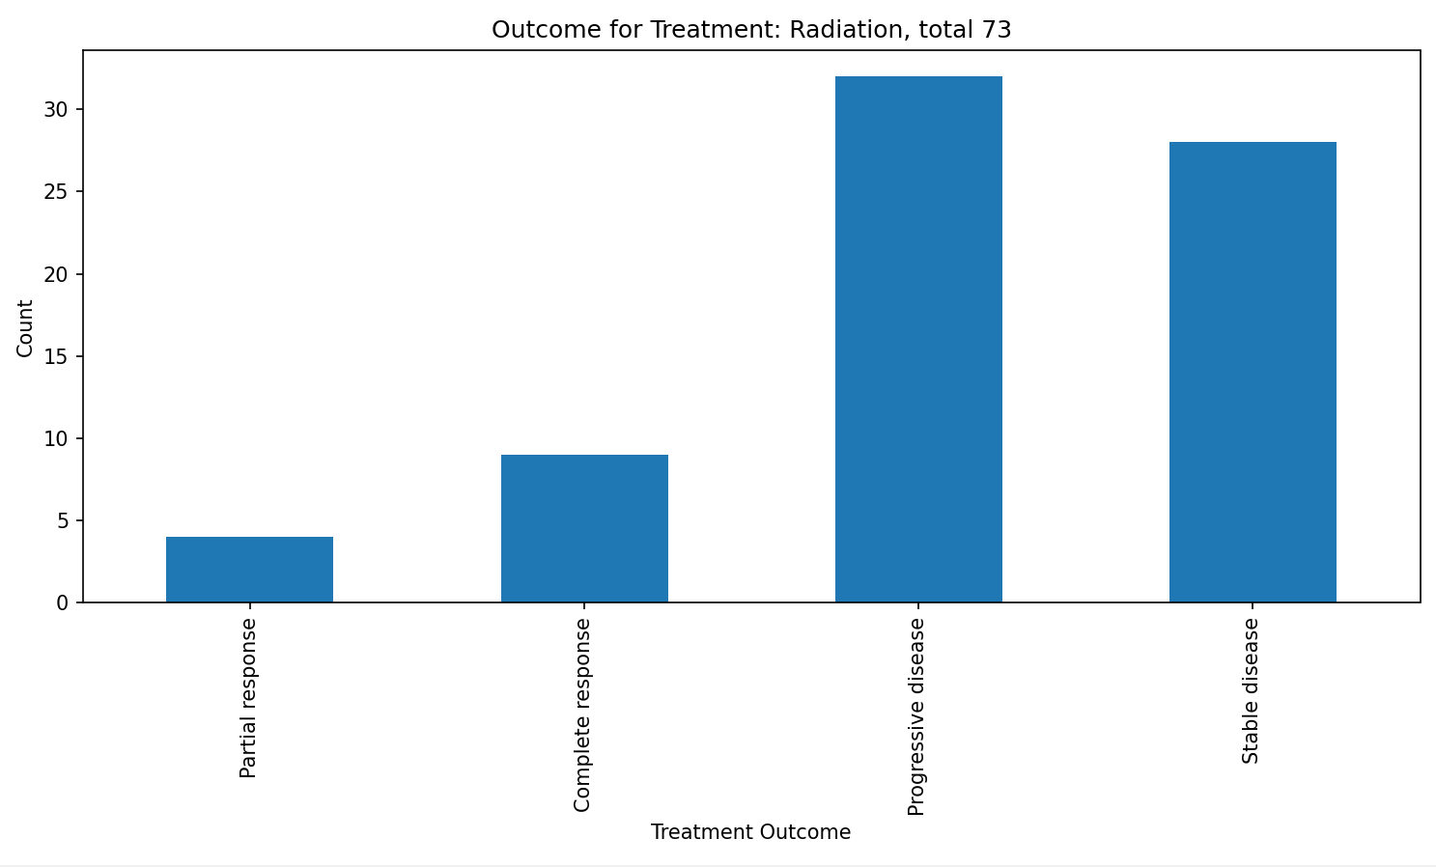
4. Can we predict the treatment outcome based on the chosen treatment?
Results

Slide 20
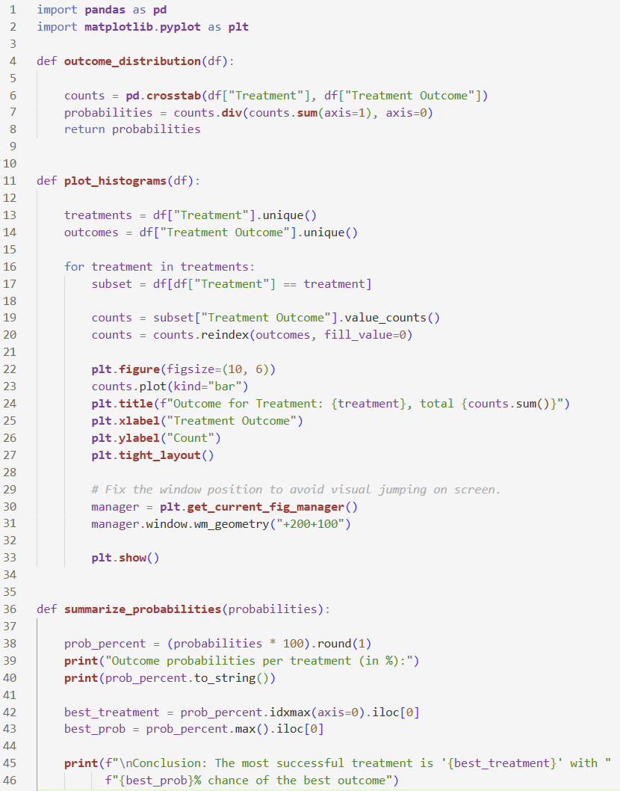
4. Can we predict the treatment outcome based on the chosen treatment?
Final code

Slide 21
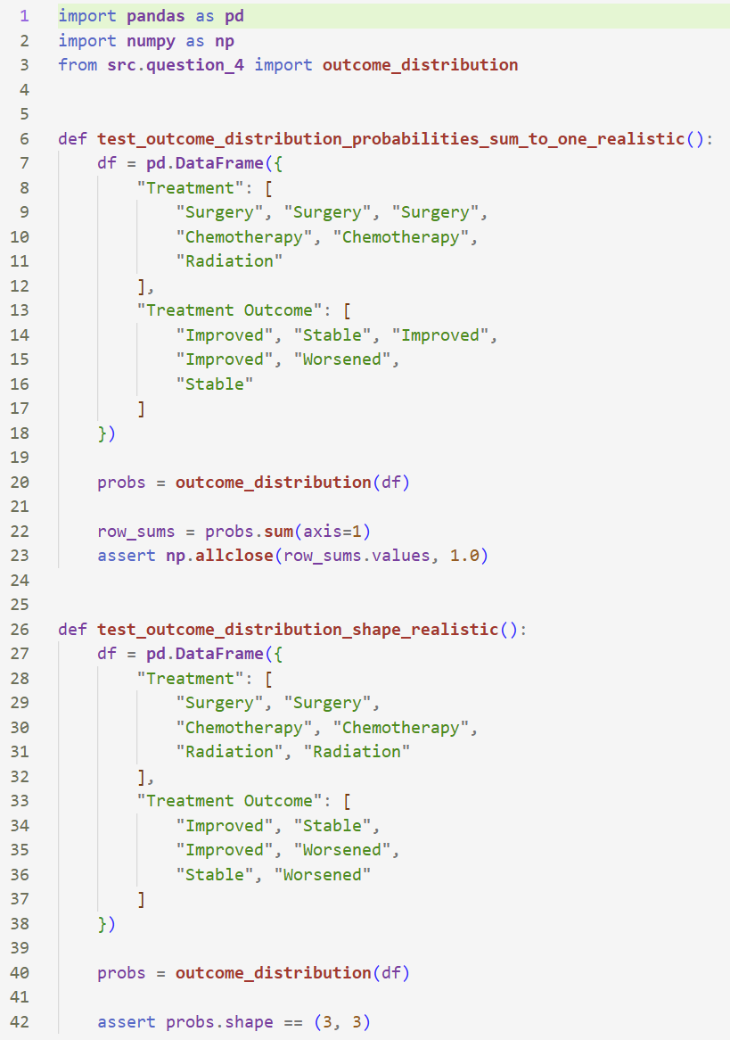
4. Can we predict the treatment outcome based on the chosen treatment?
Tests

Slide 22
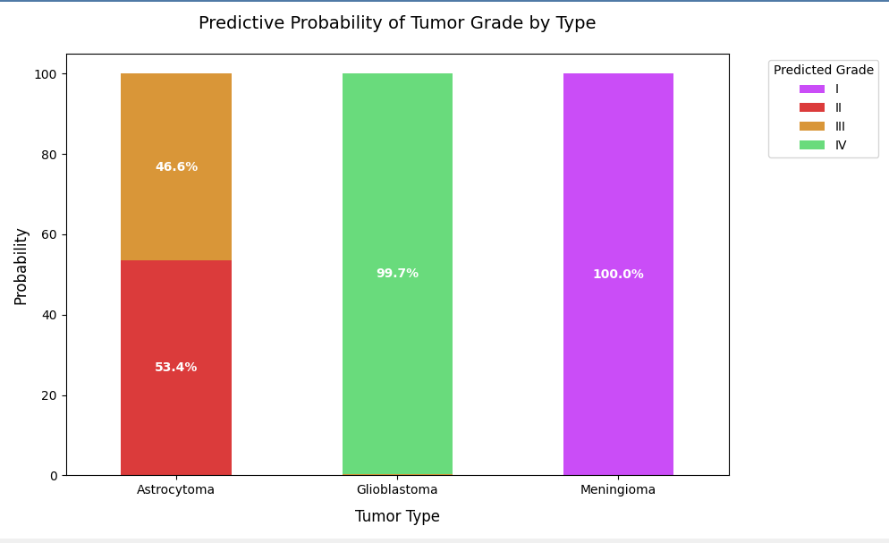
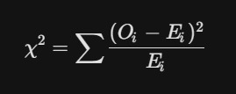
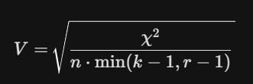
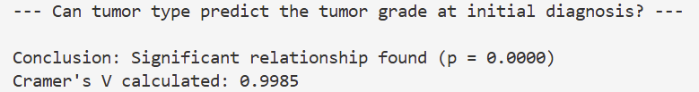
5. Can tumor type predict the tumor grade at initial diagnosis?
Results
The initial assumption was that tumor type would not be able to predict tumor grade, but the results showed that each tumor type was associated with specific grades, indicating a clear relationship.
A cross-tabulation examined the relationship between tumor type and tumor grade. A chi-square test showed a statistically significant association, and Cramér’s V indicated that the relationship is strong. A stacked bar chart with percentages was used to clearly compare grade distributions across tumor types, even with different sample sizes.

Slide 23
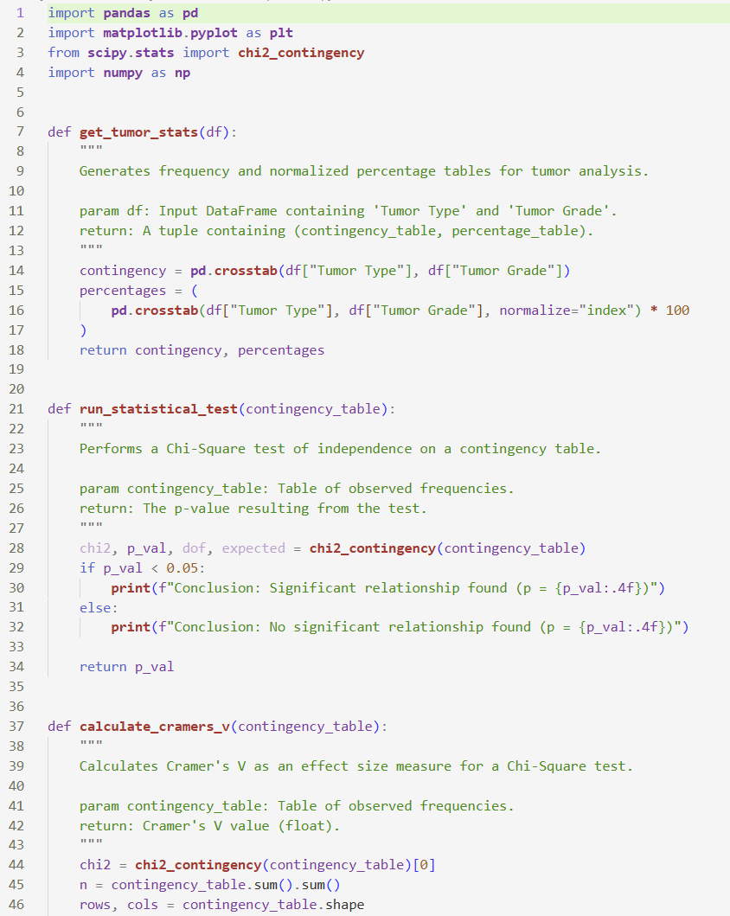
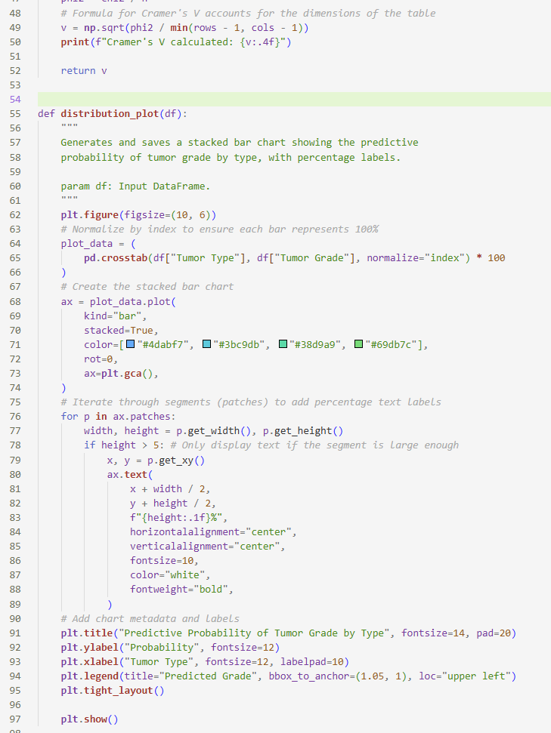
5. Can tumor type predict the tumor grade at initial diagnosis?
Final code

Slide 24
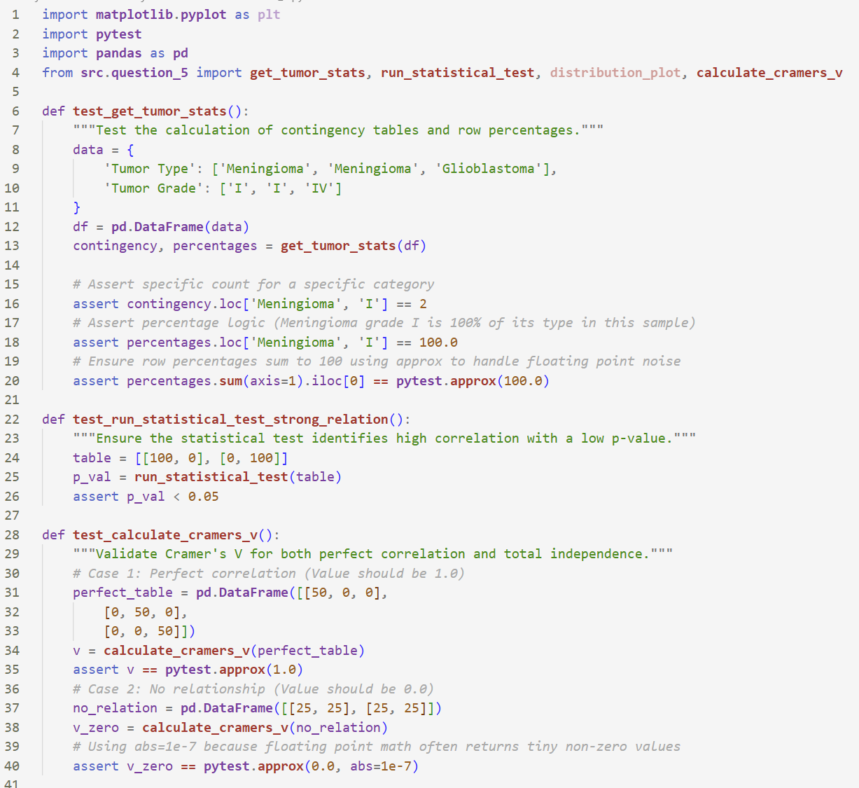
5. Can tumor type predict the tumor grade at initial diagnosis?
Tests

Slide 25
Thanks for watching

